Slide 1
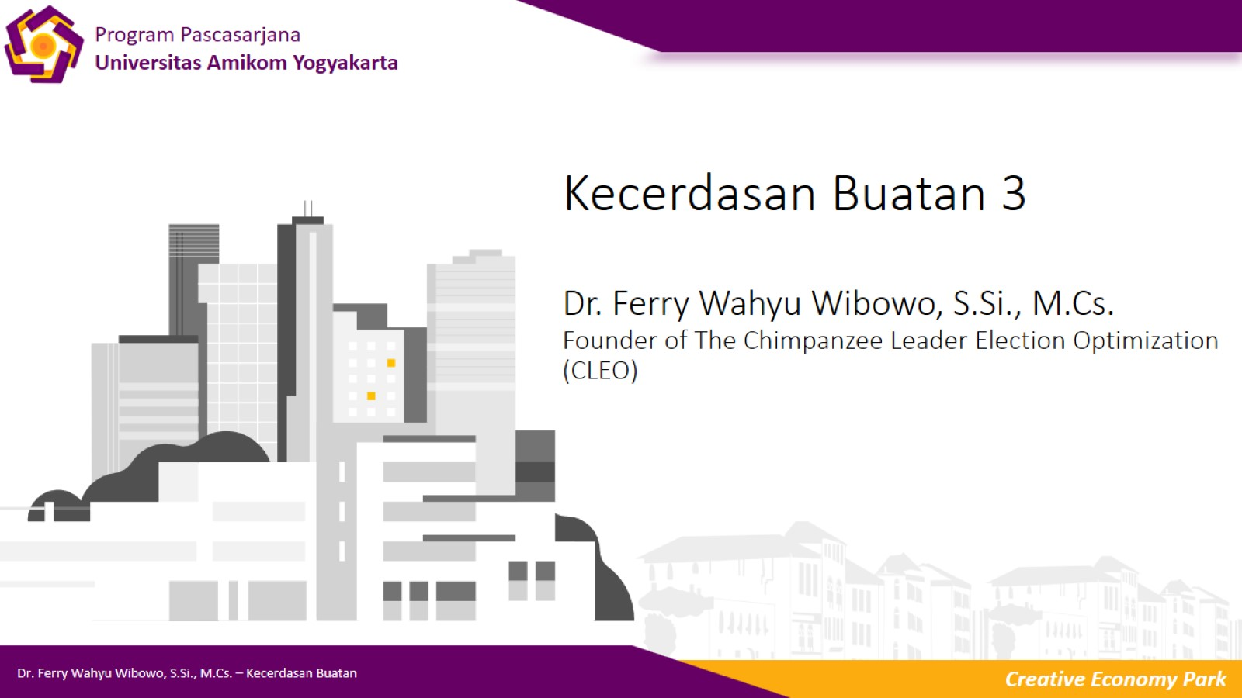
Kecerdasan Buatan 3
Dr. Ferry Wahyu Wibowo, S.Si., M.Cs.
Founder of The Chimpanzee Leader Election Optimization (CLEO)

Slide 2

Agenda

Slide 3
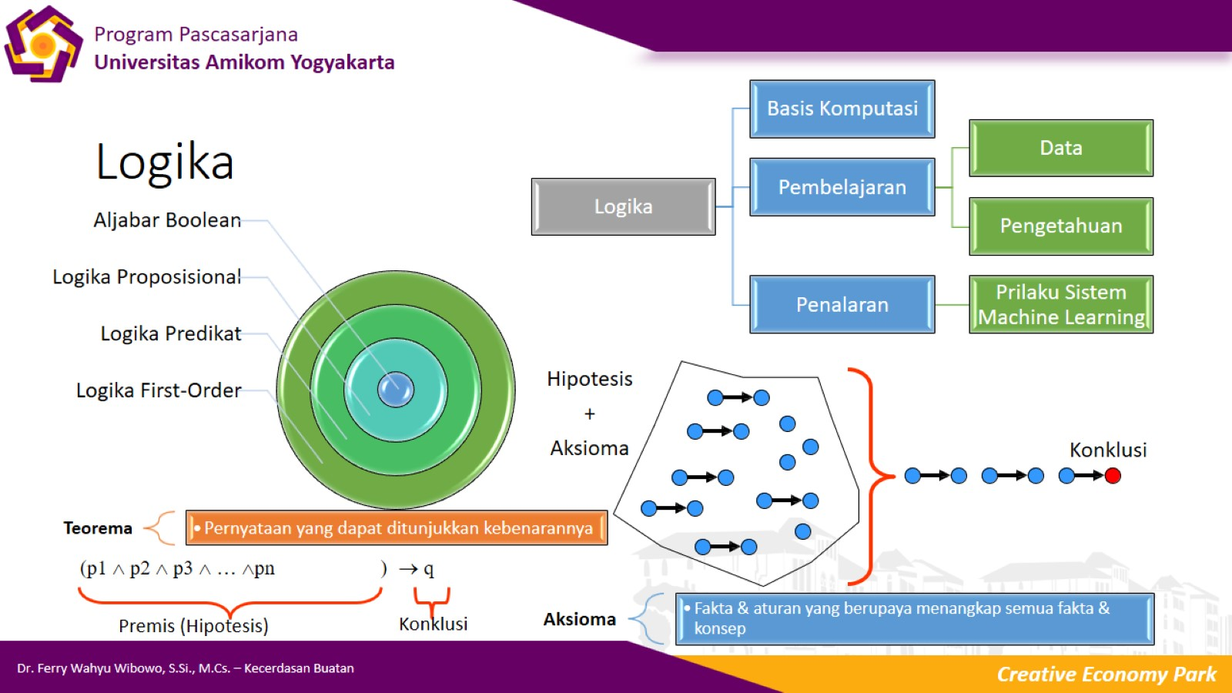
Logika

Slide 4
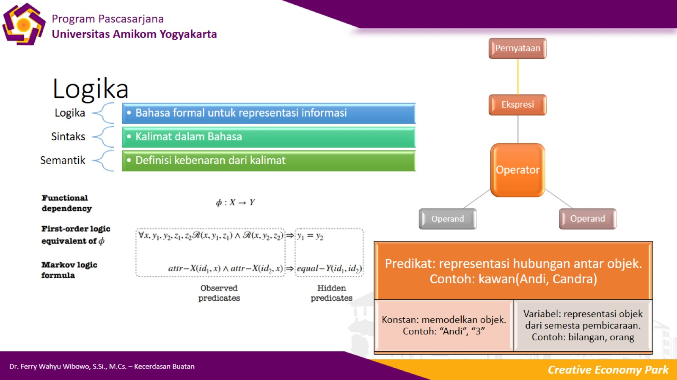
Logika

Slide 5
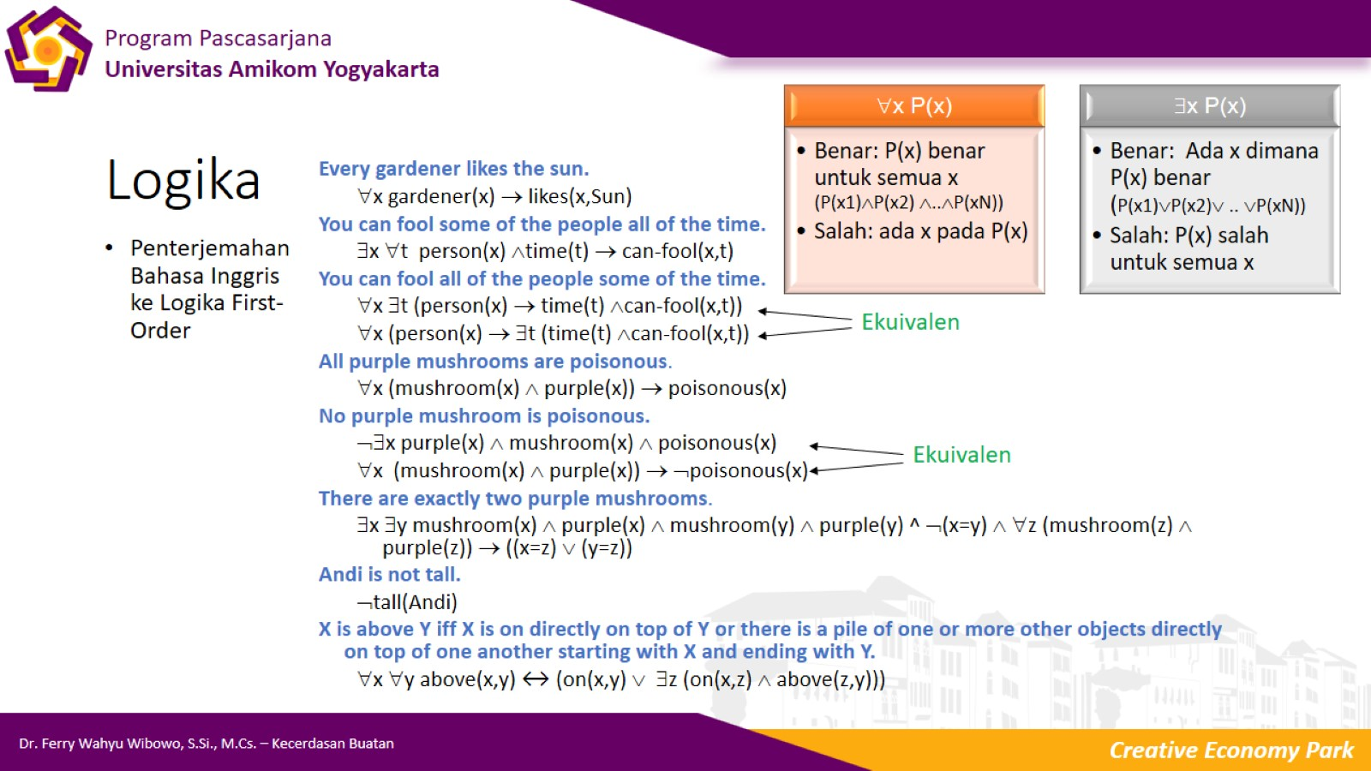
Logika

Slide 6
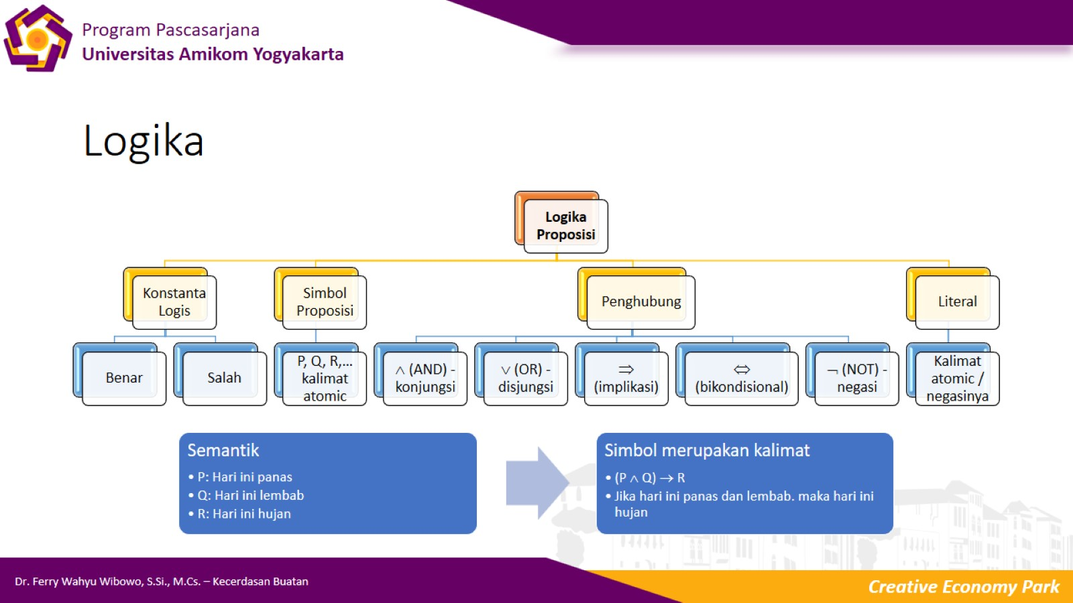
Logika

Slide 7
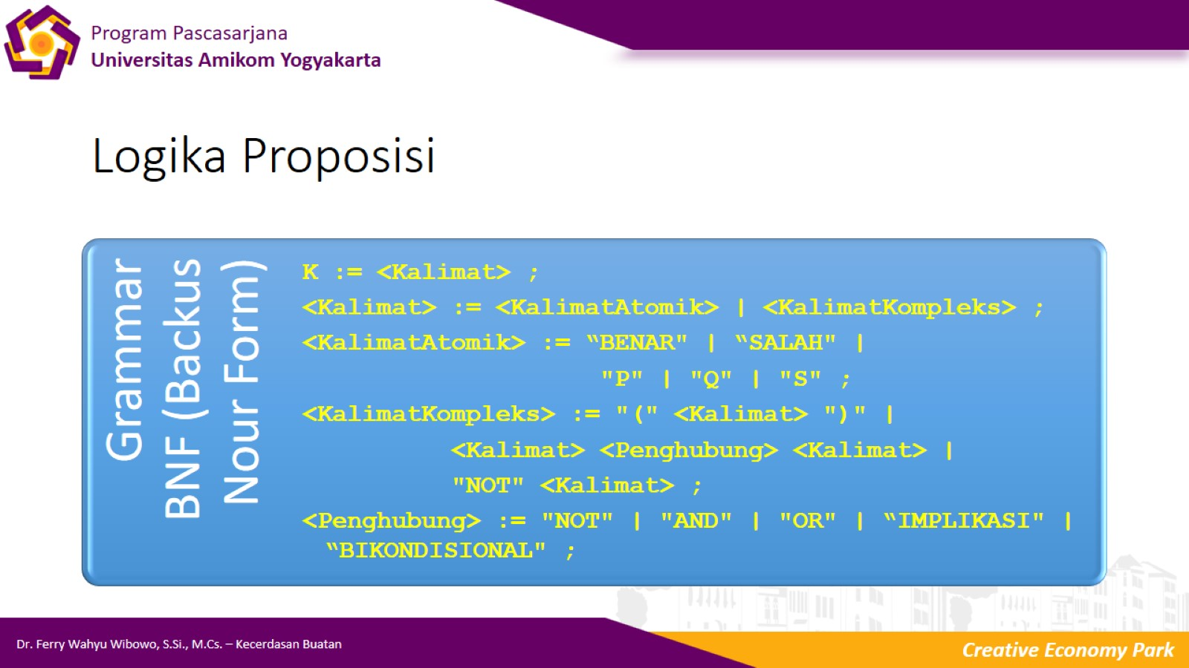
Logika Proposisi

Slide 8
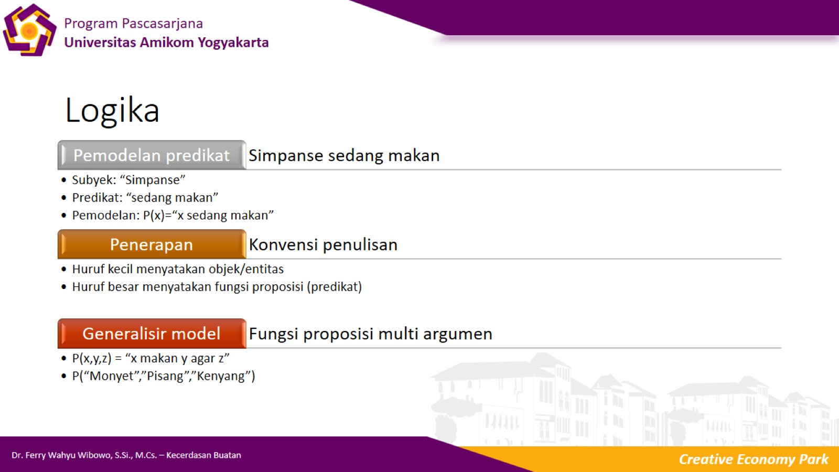
Logika

Slide 9
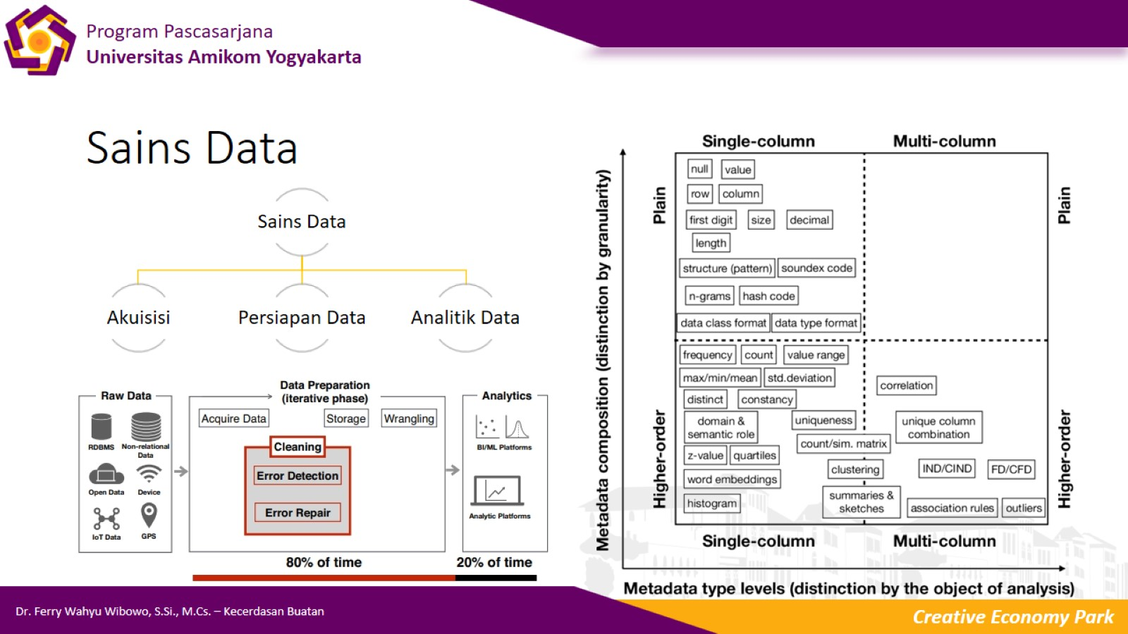
Sains Data

Slide 10

Terima Kasih

